Slide 1
Unicast Routing Protocols
An internet is a combination of networks connected by routers.
When a datagram goes from a source to a destination, it will probably pass through many routers until it reaches the router attached to the destination network.

Slide 2
Cost or Metric
A router receives a packet from a network and passes it to another network.
High throughput means low cost and the low throughput means high cost.
Low delay is low cost and high delay is high cost.

Slide 3
Static versus Dynamic Routing Tables
A static table is one with manual entries.
A dynamic table, on the other hand, is one that is updated automatically when there is a change somewhere in the internet.
The tables need to be updated as soon as there is a change in the internet.

Slide 4
Routing protocols
Routing protocols have been created in response to the demand for dynamic routing tables.
A routing protocol is a combination of rules and procedures that lets routers in the internet inform each other of changes.
It allows routers to share whatever they know about the internet or their neighborhood.

Slide 5
Intra and Inter domain routing
Routing protocols can be either an interior protocol or an exterior protocol.
An interior protocol handles intradomain routing; an exterior protocol handles interdomain routing
One routing protocol cannot handle the task of updating the routing tables of all routers.
An internet is divided into autonomous systems.

Slide 6
Intra and Inter domain routing
An autonomous system (AS) is a group of networks and routers under the authority of a single administration.
Routing inside an autonomous system is referred to as intra-domain routing.
Routing between autonomous systems is referred to as inter-domain routing.

Slide 7
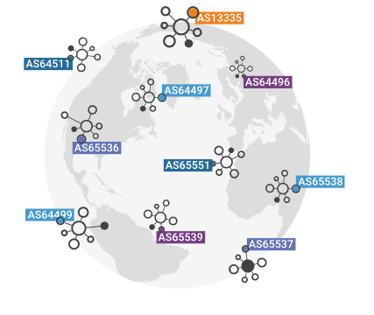
Autonomous system

Slide 8
Intra and Inter domain routing
Each autonomous system can choose one or more intradomain routing protocols to handle routing inside the autonomous system.
Only one interdomain routing protocol handles routing between autonomous systems.

Slide 9
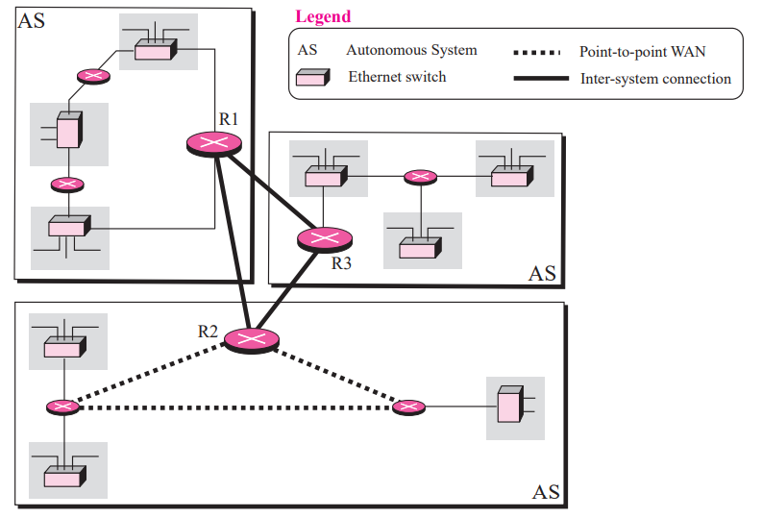

Slide 10
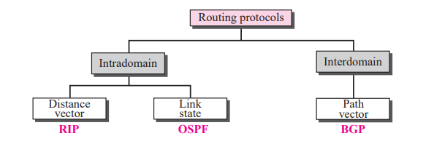
Routing Protocols

Slide 11
Intra and Inter domain routing
RIP and OSPF are interior routing protocols;
BGP is an exterior routing protocol.
Routing Information Protocol (RIP) is the implementation of the distance vector protocol.
Open Shortest Path First (OSPF) is the implementation of the link state protocol. Border Gateway Protocol (BGP) is the implementation of the path vector protocol.

Slide 12
Distance vector routing
In distance vector routing, the least cost route between any two nodes is the route with minimum distance.
In this protocol each node maintains a vector (table) of minimum distances to every node
The graph theory used an algorithm called Bellman-Ford (also called Ford-Fulkerson) for a while to find the shortest path between nodes in a graph given the distance between nodes.

Slide 13
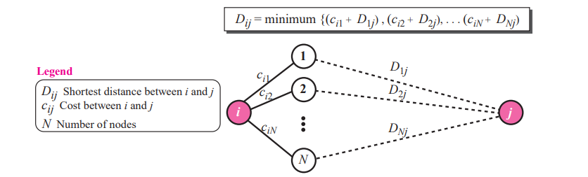
Bellman-Ford algorithm

Slide 14
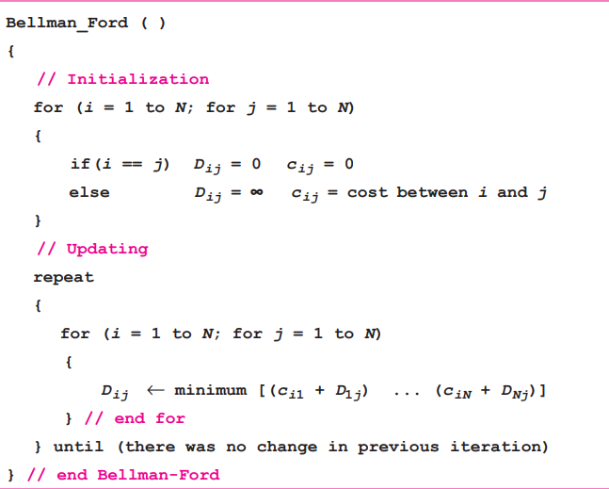
Bellman-Ford algorithm Pseudocode

Slide 15
Distance vector routing
In distance vector routing, the cost is normally hop counts
Each router needs to update its routing table asynchronously
After a router has updated its routing table, it should send the result to its neighbors.
Each router should keep at least three pieces of information for each route: destination network, the cost, and the next hop
Each route received from a neighbor as R (record), which has only two pieces of information: R.dest and R.cost.

Slide 16
Updating process
When a record arrives, the router searches for the destination address in the routing table.
If the corresponding entry is found, two cases need to be checked and the route information should be changed.
  If the record cost plus 1 is smaller than the corresponding cost in the table
  If the next hop is the same, it means some change has happened in some part of the network.
If the entry is not in the table, the router adds it to the table and sorts the table according to the destination address.

Slide 17
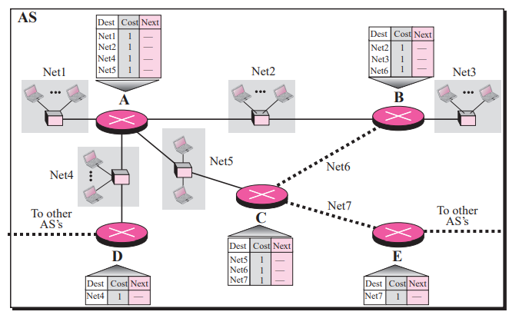
Initial routing table for an AS

Slide 18
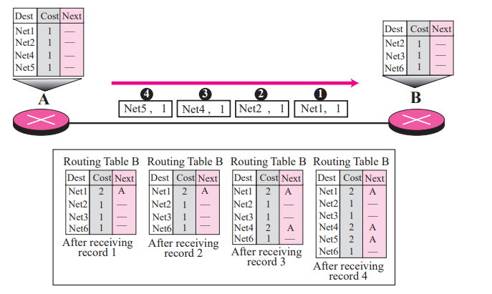
Router A sends four records to its neighbors

Slide 19
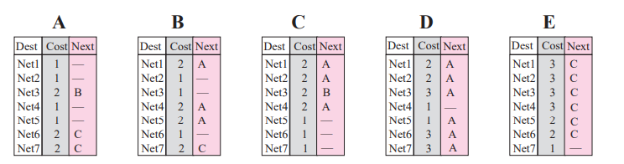
Final routing tables for routers

Slide 20
Count to Infinity
A problem with distance vector routing is that any decrease in cost (good news) propagates quickly, but any increase in cost (bad news) propagates slowly.
For a routing protocol to work properly, if a link is broken (cost becomes infinity), every other router should be aware of it immediately, but in distance vector routing, this takes some time. The problem is referred to as count to infinity.

Slide 21
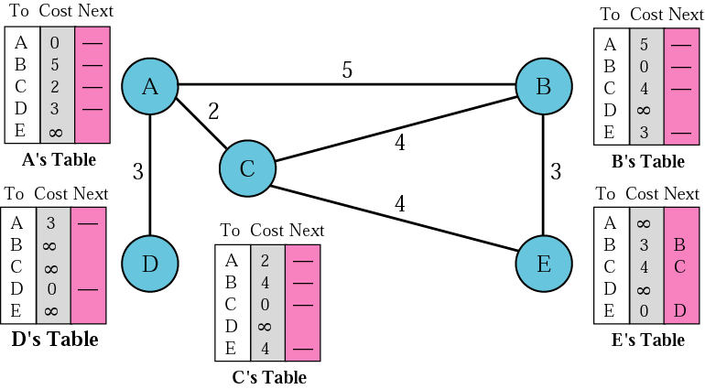
Initialization of tables in distance vector routing

Slide 22
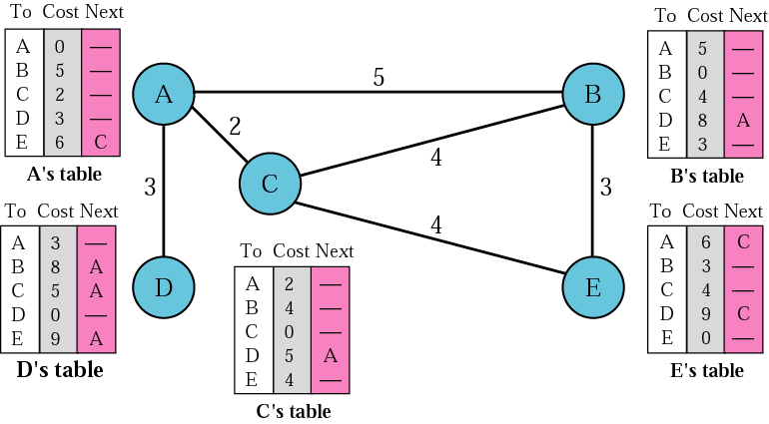
Distance vector routing tables

Slide 23

Note:
In distance vector routing, each node shares its routing table with its immediate neighbors periodically and when there is a change.

Slide 24
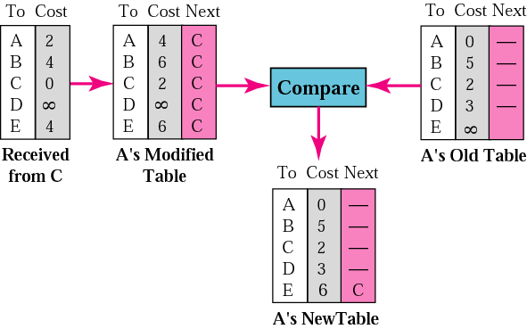
Updating in distance vector routing

Slide 25
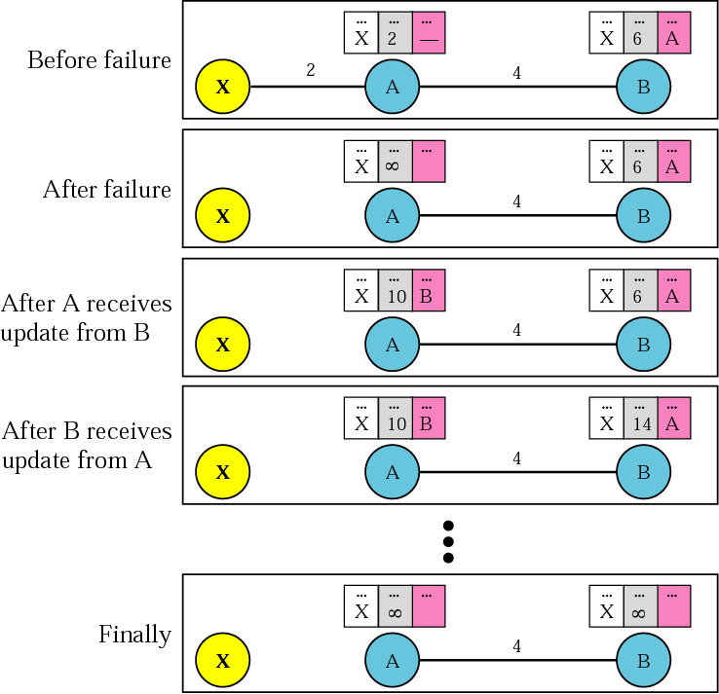
Two-node instability

Slide 26
Solutions have been proposed for instability
Defining Infinity- Distance Vector Protocol define 16 as infinity.
The size of the network, in each direction, can not exceed 15 hops.
Split Horizon- Instead of flooding the table through each interface, each node sends only part of its table through each interface.

Slide 27
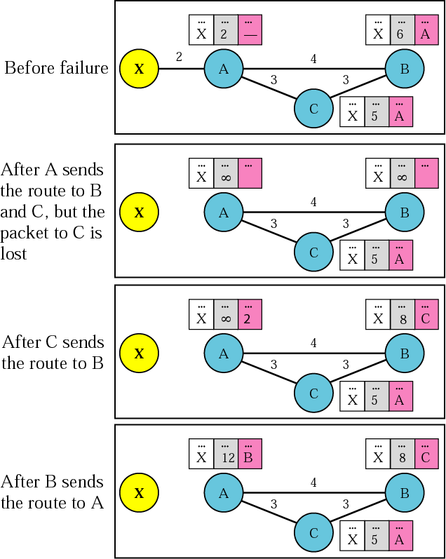
Three-node instability

